Slide 1

Amrutvahini College of Engineering, Sangamner
Implementing Deep Neural Network Based Encoder-Decoder Framework for Image Captioning
Team members:
Mr. Mayur Gadakh (4136)
Mr. Gaurav Chaudhari (4117)
Ms. Akanksha Gaikwad (4141)
Ms. Shivanjali Dhage (4126)
Guide: Mr. R. S. Gaikwad

Slide 2
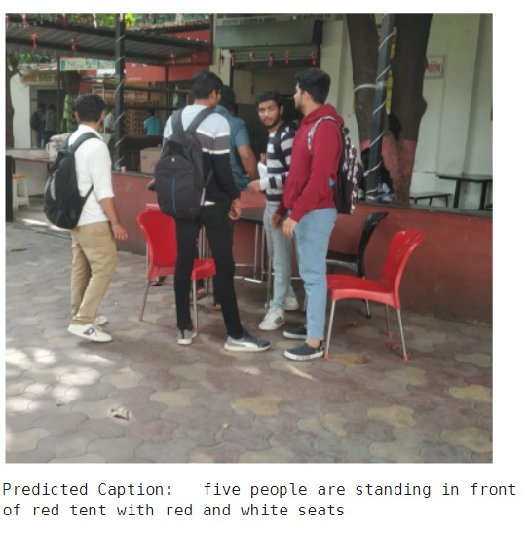
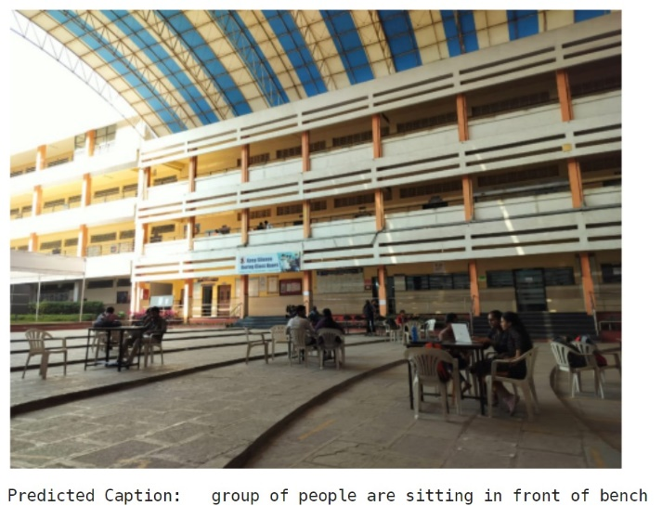
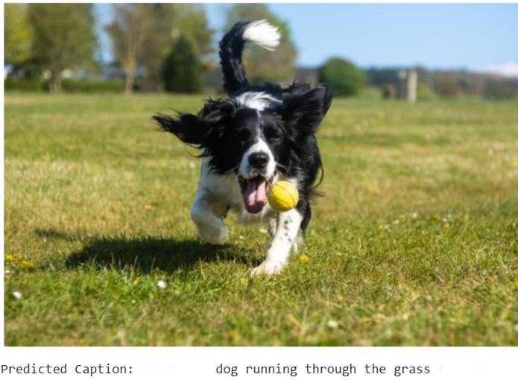
Problem Statement:
Implementing Deep Neural Network Based Encoder-Decoder Framework for Image Captioning using EfficientNetV2 as encoder and GRU as decoder.

Slide 3
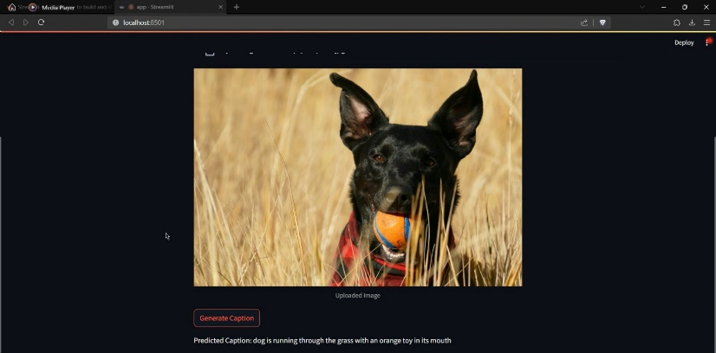
Objectives :
To study the deep learning techniques like CNN and RNN.
To develop a deep-learning based image caption generator that can accurately describe the contents of an image in natural language.
To create a user-friendly interface for interacting with the image captioning system.
To compare efficiency and accuracy of our model with existing model.

Slide 4
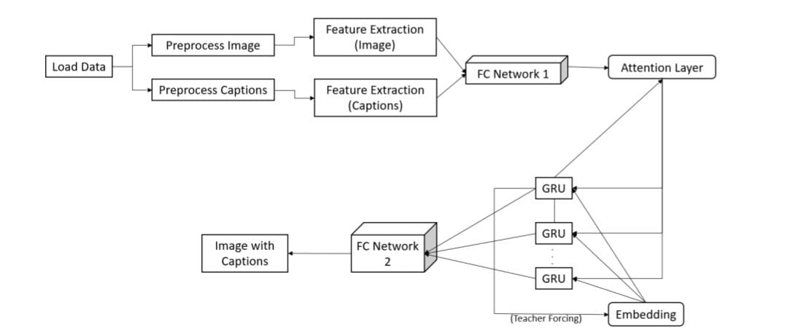
Block Diagram

Slide 5
Advantages
• Auto Descriptions
• Accessibility
• Retrieval Efficiency
• Personalization
Disadvantages
Overfitting
Misclassification

Slide 6
Applications
Social Media
Content Recommendation
E-commerce
Education

Slide 7
Thank You !

